Slide 1

TASK-7
Plotting Trend Lines on HDFC_BANK_CSV Dataset
SATISH NAGAR
DATA SCIENCE INTERN
AT HACKVEDA LTD.

Slide 2
Table of contents
01
Hook-story
03
Candlestick
plot
02
Introduction
04
Trend-line

Slide 3
Table of contents
09
Reference
05
Combined
plotting
07
Future
scope
06
Flow of
project
10
Contact
08
Conclusion

Slide 4


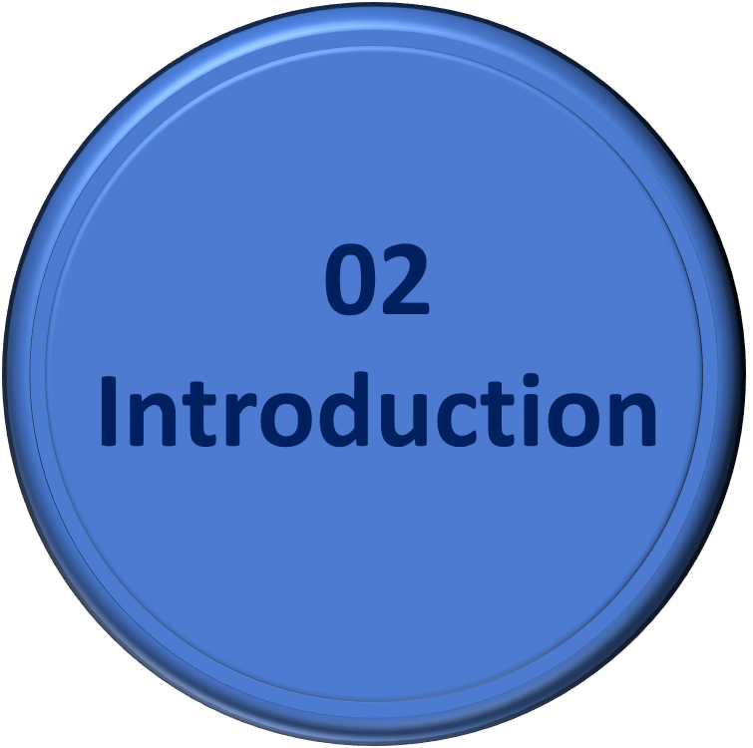

Table of contents

Slide 5
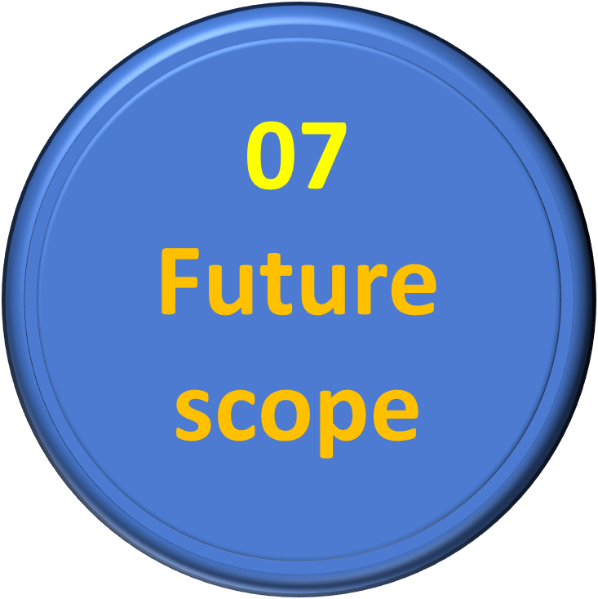

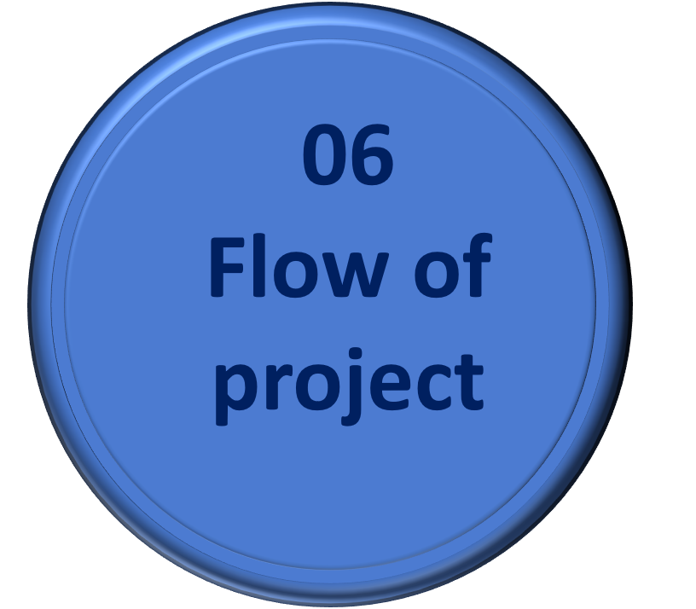

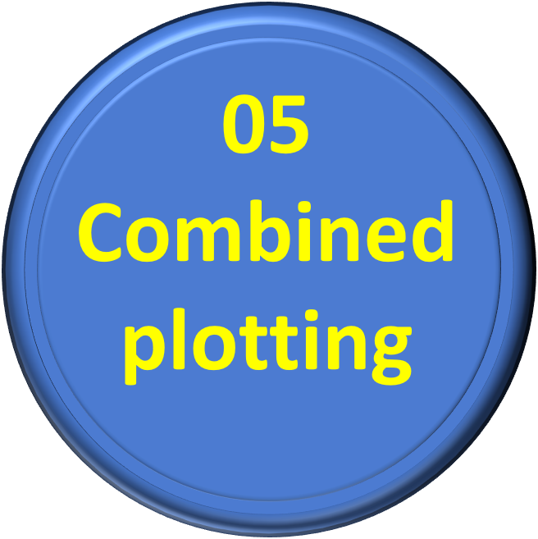
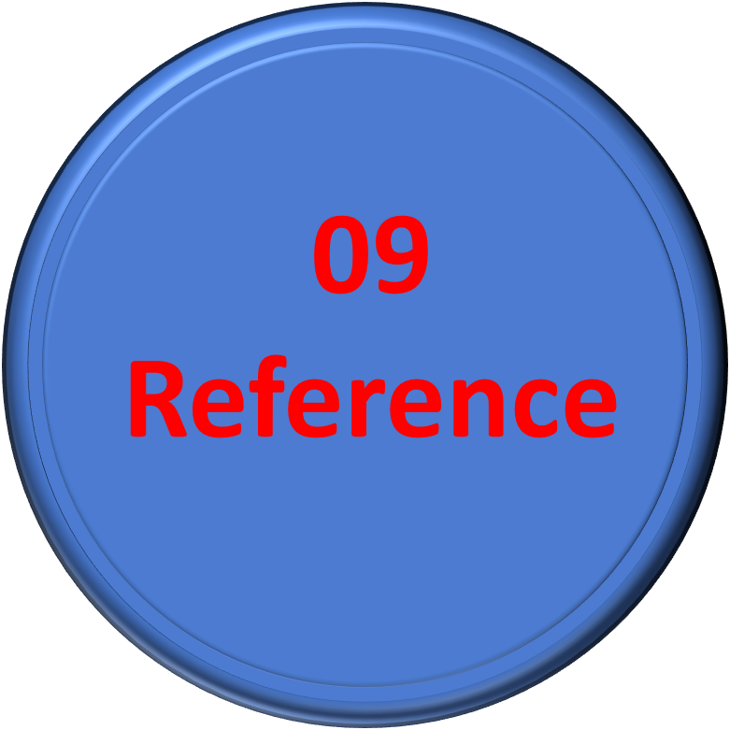
Table of contents

Slide 6

HOOK – STORY
Sahil's Stock Market Journey:
Challenge He Faced:
Discovery of Trend Lines: He learned about trend lines
Breakthrough Moment: HDFC Bank's stock .
Impact of Knowledge

Slide 7

Introduction
Stock Market Dynamics (uptrend/downtrend)
Candlestick Charts: A Visual Tool
Trend Lines: The Guide to Direction (it act as a road map)
Motive of the Project

Slide 8

TERMINOLOGY
UP_TREND
when stock prices form higher highs and higher lows consistently over time.
A company announces strong quarterly earnings.
Price Movement: The stock price moves from ₹1500 to ₹1550/1520, then to ₹1600/1570, forming a series
DOWN_TREND
A downtrend is characterized by lower highs and lower lows in the stock price
A company faces negative news, like regulatory issues.
Price Movement: The stock price declines from ₹1200 to ₹1150, then to ₹1170/1100, forming lower highs and lower lows.
BACK

Slide 9
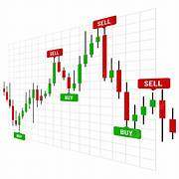
Candlestick Plotting
Benefits:
Shows detailed price movement.
Easy to identify market patterns.
Features:
Includes open, close, high, and low prices.

Slide 10
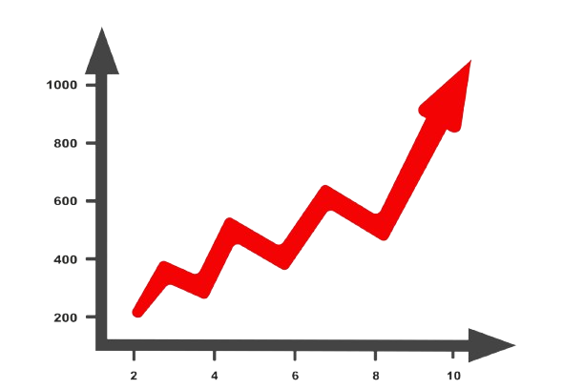
Trend lines
Benefits:
Identifies market direction.
Helps predict future price movements.
Features:
Connects significant highs/lows.
Provides visual clarity for trends.

Slide 11
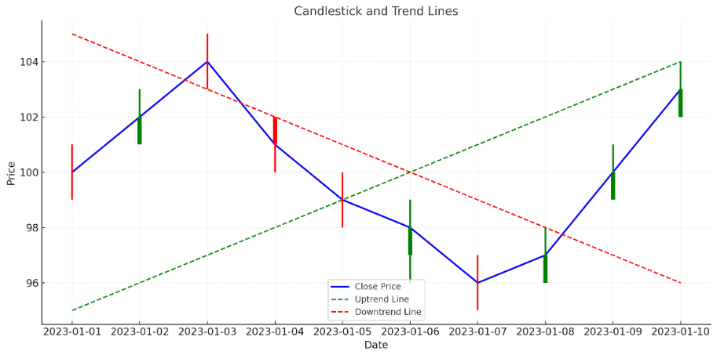
Combined Use of Candlesticks and Trend Lines
Candlesticks Show Price Action
Trend Lines Highlight Direction
Together: Complementary Analysis
Decision-Making Tool

Slide 12






Flow of Project
Importing libraries
FOR MORE –Click HERE
Importing Data
FOR MORE –Click HERE
STEPS
DATA Preprocessing
FOR MORE –Click HERE
Trend Lines
FOR MORE –Click HERE

Slide 13
Step 1 : Importing Libraries
Import required libraries:
Pandas
Numpy
Matplotlib:
pip install matplotlib
OR
conda install matplotlib
Seaborn

Slide 14
Step 2 – Importing Data
Download the HDFCBANK CSV dataset
Use the pandas library in Python to read the CSV file into a dataframe

Slide 15
Step 3 : Data Preprocessing
Clean and format the data
Includes steps such as:
Converting the 'Date' column to datetime format.
Setting the 'Date' column as the DataFrame's index.

Slide 16
Step4 : Creating Trend Lines
The main objective of the project is to create a Trend Lines to visually represent HDFC BANK DATASET.
Use the matplotlib library to plot the closing price of HDFCBANK over time.
Demonstrate how to plot trend lines on HDFCBANK CSV dataset

Slide 17

Future Scope
Automate trend analysis with AI.
Real-time data integration.
Develop predictive models for investment.

Slide 18

Conclusion
Trend lines and candlesticks provide actionable insights.
Combined use improves analysis accuracy.
A step closer to smarter investing.

Slide 19
Reference
Data set : https://trello.com/1/cards/6438c561324b51d6acb221e1/attachments/645109ea1d9383a766147bd9/download/StockDataHDFCBANK.csv
Youtube:
https://www.youtube.com/watch?v=c-2QGutM4sw&t=1974s
3. ChatGpt

Slide 20



Contact
For any queries,
feel free to reach out at
satishnagar248@gmail.com
www.linkedin.com/in/satish-nagar-nilu

Slide 21
Thank-you☺

